Slide 1


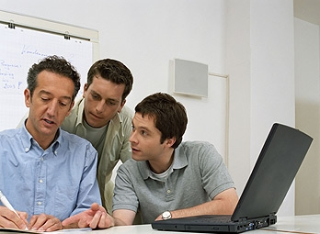

HEALTHY MEN AT WORK PROGRAM

Slide 2
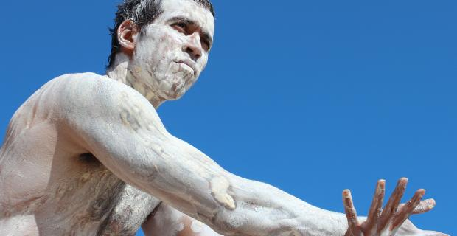
I would like to show my respect and acknowledge the traditional custodians of the land on which we meet today and pay my respects to them and their culture, and to the elders both past and present.

Slide 3

I provide a range of male friendly services with a focus on improving the state of male health and wellbeing, thus improving the wellbeing of the whole community.
Professional Training Programs – ENGAGING MEN
Men’s programs – MEANING FOR MEN, Managing Depression & Anxiety, Understanding Relationships, Understanding Difficult Emotions, Men’s Sexual Health & Wellbeing, Healthy Men at Work
Project and research work – Beyond Blue, PCFA, wide range of clients
MY BACKGROUND
Health Social Worker 36 years | Men’s health worker30 yrs
President, Men’s Health Forum NSW Inc
Vice President, Australian Men’s Health Forum Inc. (AMHF)
Casual Academic, School of Medicine and Public Health, University of Newcastle
Member, Board of Advisors, Men’s Health Network USA
Author of “Men’s health & wellbeing: an a-z guide”

Slide 4

HOLISTIC HEALTH MODEL
or biopsychosocial model
✪ physical / biological
✪ cultural
✪ social
✪ spiritual
✪ psychological
Notes:
Benefits of viewing health as adaptation to circumstances
-It is realistic and pragmatic. The view of health as adaptation moves away from what may be seen as an unhealthy yearning and preoccupation with trying to achieve an ideal yet unattainable state of perfect health.
-It accords with lay approaches to health. In everyday terms, people want health not as an end in itself but rather so that they can get on with their lives. Health is something a person can leagely take for granted when life is progressing as normal.
-It emphasizes the environment as well as the individual. The idea of health as adaptation leads to the practical implications that the promotion of health requires attention to both the individual person’s adaptability and to the environment’s adaptability

Slide 5
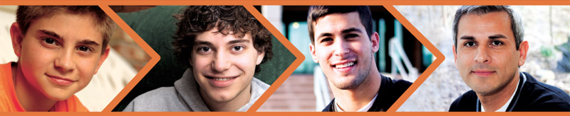
AUSTRALIAN MEN’S HEALTH & WELLBEING – THE BIG PICTURE
Life expectancy for men lower 79.9 (84.3 for women)*
Men in all age ranges die at greater rates
6 out of 8 suicides in Australia are male (highest nos. young men and 30-50 age group)
Men’s use of health services is lower (both preventative and acute)
Men get into more risk taking activities
Men experience emotional stress but don’t seek out support in the same way women do
The importance of Gender Medicine – our bodies are built differently
* Australian Institute of Health and Welfare

Slide 6


WHAT ABOUT THE GOOD NEWS?
There are some key changeable risk factors that we can improve on if we need to like diet, exercise, alcohol use, dealing with stress and emotions and having a health plan with your GP
Men are very effective when they decide to change any of these key risk factors and their health is markedly improved
Men and boys are changing and becoming more aware that their health and wellbeing
We have a National Male Health Policy and Ten to Men a National Longitudinal Study on male health & wellbeing
www.tentomen.org.au/

Slide 7

10 THINGS MEN NEED TO KNOW
TO LIVE LONGER AND HAPPIER LIVES

Slide 8
① WORK WITH YOUR DOCTOR
Have a regular GP and make a health maintenance plan with him
You probably have a maintenance plan for your car or your computer, but you’re more important!!
Find out what health checks you need for your age | Know your family medical history
Stick to your plan by following up with tests and checking your results
Make a regular time for a check up – put it in your diary or ask your GP send you a reminder letter
REMEMBER A MAN WITH A PLAN
can be dangerously well informed!!

Slide 9
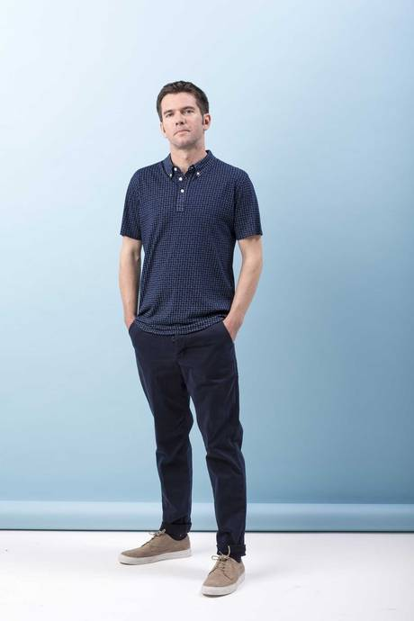
②BE AWARE OF ANY CHANGES IN YOUR BODY
Observe your body and don’t ignore changes – check them out and fix
them. Would you drive a car with a flat tyre?
7 WARNING SIGNS OF CANCER:
A change in bowel or bladder habits
A sore that does not heal
Unusual bleeding or discharge from any place
A lump in the testicle [for men under 40] or other parts of the body
Chronic indigestion or difficulty in swallowing
Obvious changes in a wart or mole
Persistent coughing or hoarseness
Be alert, not alarmed – all these changes could be something else not
cancer but you need to know
Early detection = Better outcomes
Cancer will effect one in two men in their lives and one in three women.
But more people survive with early detection & improved treatments.

Slide 10
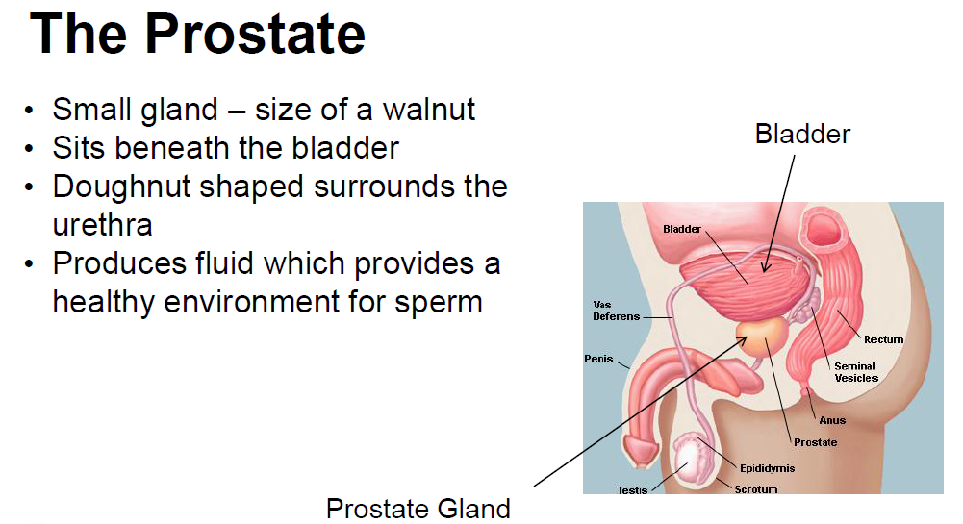
1 in 7 men over 40 years report prostate problems
More men are diagnosed with prostate cancer than women with breast cancer

Slide 11
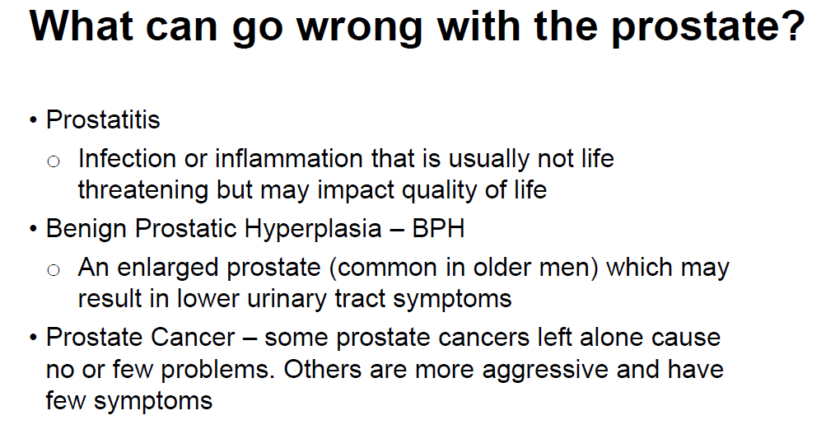

Slide 12
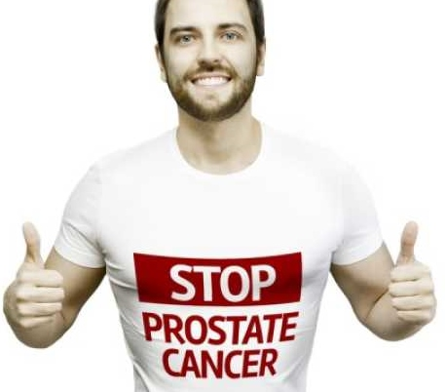
PROSTATE CANCER RISK FACTORS
Family history – father, brother, uncle
Diets high in animal fat, too less vegies
Age – risk is higher as you get older
Testing now recommended for men from 40 with a family history.
With no family history men over 50 should have a test annually.
Tests are simple
Prostate Specific Antigen (PSA ) blood test only
No PR test needed now.
Prostate cancer is not an old man’s disease
There are no symptoms in early stage prostate cancer
1 in 8 men, over 50, will develop prostate cancer in their lifetime
Survival rate is good if detected early

Slide 13
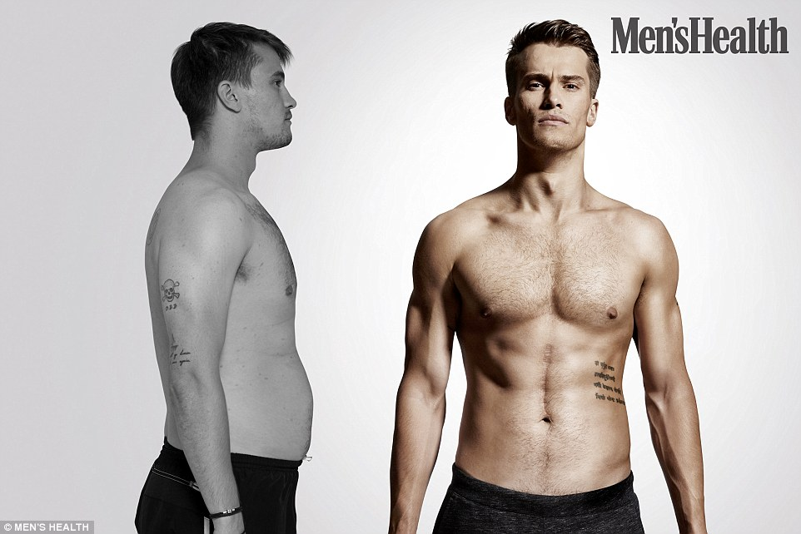
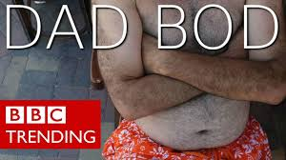
③BE AWARE OF YOUR WAIST
– it’s the best guide to your weight
37 inches |94 cm = overweight and need to lose some kilos
40 inches |101.6 cm = danger of becoming obese and you do need to lost some weight and talk to your doctor
Measure waist size around the middle
in line with your belly button
Don’t be anxious about body image, not everyone wants to look like the Men’s Health Cover guy.
Rise of the “dad bod” some weight is healthy

Slide 14

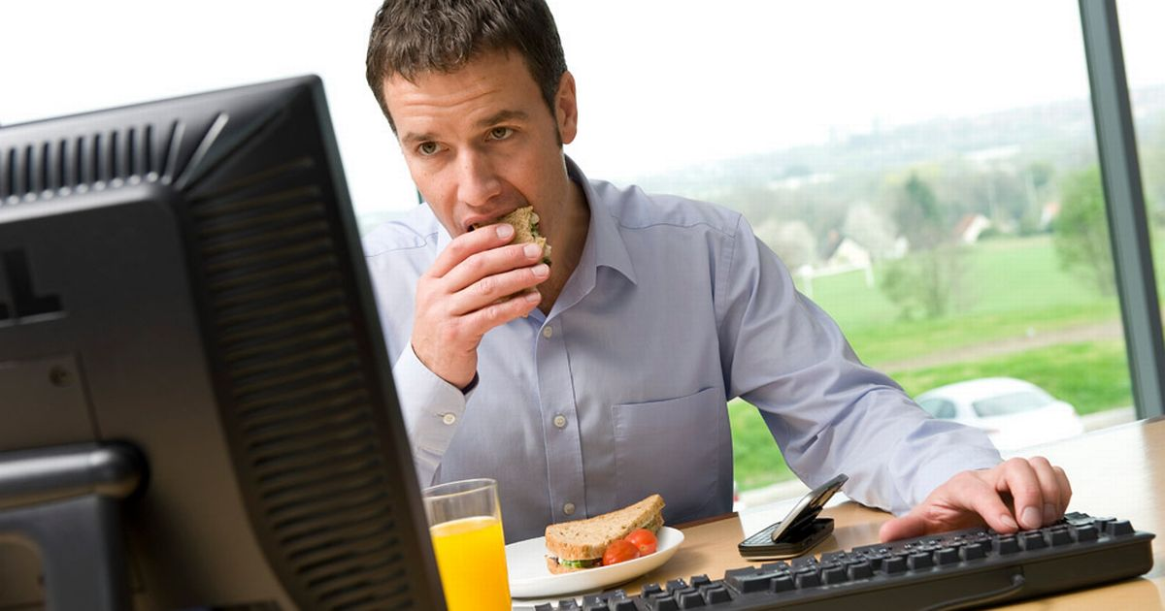
❍ THINK ABOUT WHAT YOU EAT
Eat more fish and less red meat
Don’t eat fat on meat
Eat less processed food in general
5 vegetables 2 fruit potions daily
Consider healthy snack options
like baked chips not fried
Don’t eat bad food when you
feel bad/low
If you are overweight
try to eat less or smaller
meals more often
Avoid dieting

Slide 15
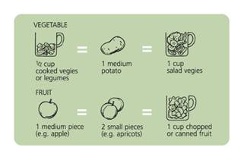
A serve of fruit is:
  1 medium piece, eg, apple, banana, orange, pear
  2 small pieces, eg, apricots, kiwi fruit, plums
  1 cup diced pieces or canned fruit
  1/2 cup juice
  dried fruit, eg, 4 dried apricot halves, 1 1/2 tablespoons sultanas.
A serve of vegetables or legumes is:
  1/2 cup cooked vegetables
  1/2 cup cooked dried beans, peas or lentils
  1 cup salad vegetables
  1 potato.

Slide 16
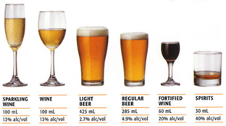
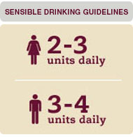
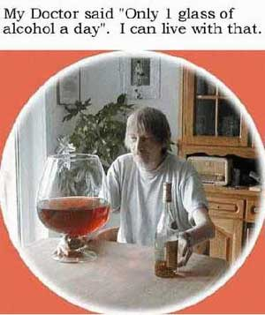
■ THINK ABOUT WHAT YOU DRINK
+ have 2 alcohol
free days a week
How food and alcohol
can increase weight

Slide 17
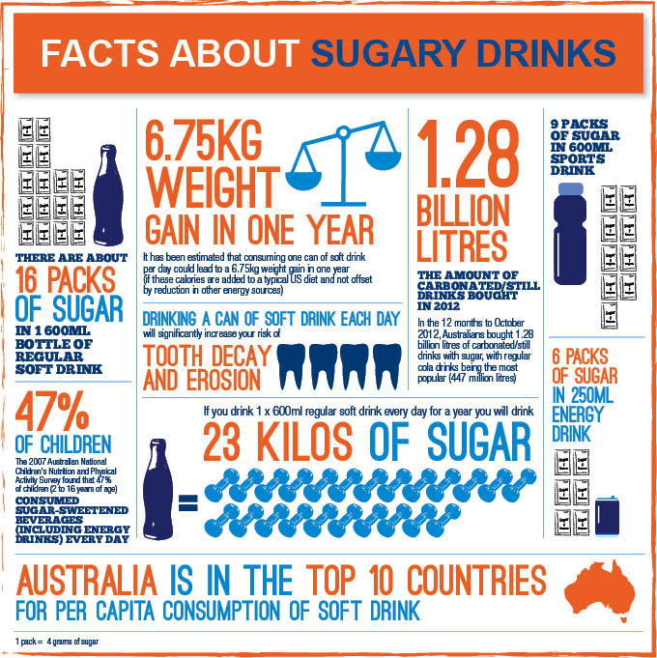
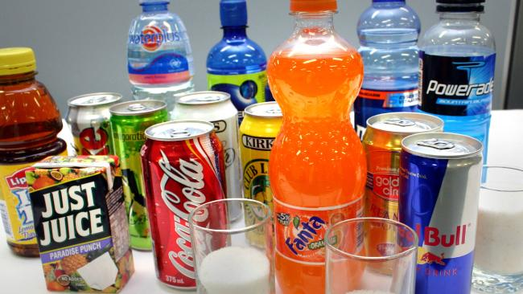

Slide 18

□MOVE MORE
Do moderately intense physical activity - walking, running, swimming, walking the dog 30 minutes a day - five days a week
Or do vigorously intense physical activity – golf, bowling, gardening, bike riding, tennis, longer walks, paddle boarding, surfing 20 minutes a day - 3 days a week
Physical activity is important for everyone no matter what weight you are
Two things make us unhealthy –
eating badly and not moving much

Slide 19


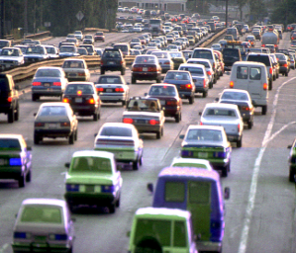

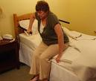
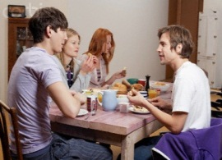



Let’s face it – we sit too much. 15 ½ hours per day for an office worker
Breakfast
15 mins
Work on
computer
3.5 hrs
Transport
From work
45 mins
Watch TV
5 hrs
Lunch
30 mins
Awake
7 am
Transport to
work
45 mins
Sleep
11pm
Evening
meal
30 mins
Walk – 30 min
Work on
computer
4 hrs

Slide 20

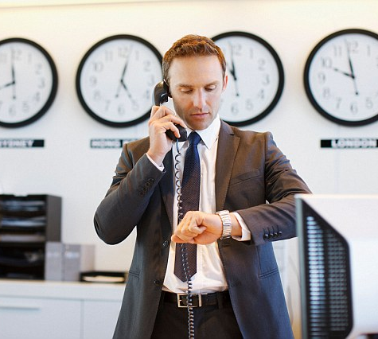
❐ TAKE TIME OUT FOR YOURSELF
Men often do a lot of things for others – family,
kids, clubs, sports, volunteer activities
You need to balance work, hobbies and life and
take time for your relationships with the most
important people in your life
Talk to your partner, family and mates
Do something you enjoy for yourself
for 3 hours every week
Take a regular holiday to refresh yourself
Don’t build up holiday leave

Slide 21

❑ DON’T FORGET YOUR SEXUAL HEALTH
The most common male sexual health problems¹:
low sexual desire – yes it does happen and we worry
erectile dysfunction
sexual performance issues – premature ejaculation
fertility issues
not getting sexually transmitted infections
relationship issues (if you are in a relationship)
40% OF AUSTRALIAN MEN OVER 18 ARE SINGLE ¹
Use condoms - great value for avoiding unwanted infections and
unscheduled kids
1. “The Health of Australian Males” Report 2011 Australian Institute of Health & Wellbeing

Slide 22

❒ CHECK YOUR MENTAL WELLBEING
Main issues are clinical depression, anxiety and stress – all of which are treatable
These problems are diagnosable illnesses like diabetes or heart disease.
There’s no point in toughing it out as it won’t go away – it needs fixing
Major treatments include medication, talking therapies – talk to someone about how you are feeling and exercise and alternative therapies.
These all work – you need to find out what works best for you.
Reduce any stress in your life, at work or at home
Lots of people work with clinical depression and anxiety and it does not affect their performance.

Slide 23
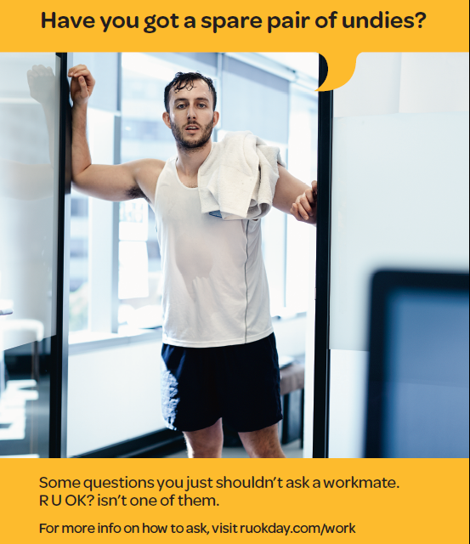
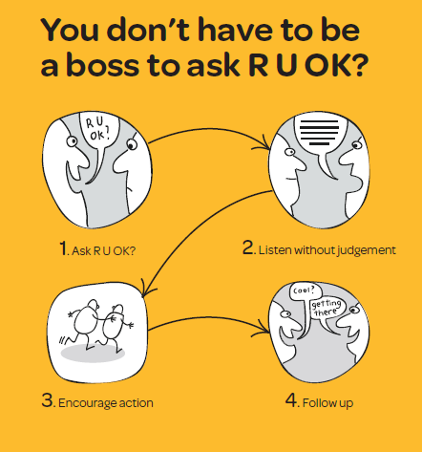

Slide 24

How to ask if someone is ok
Step One: Ask R U OK?
Be relaxed.
Help them open up by asking questions like "How you going?" or "What’s been happening?" or "How have you been travelling?
Mention specific things that have made you concerned for them, like "I've noticed that you seem really tired recently" or "You seem less chatty than usual. How are you going?“

Slide 25
Step Two: Does someone need expert help?
If someone says they’re thinking about suicide, it’s important you take it seriously.
Tell them that you care about them and you want to help.
Don’t become agitated, angry or upset.
Explain that thoughts of suicide are common and don’t have to be acted upon.
Ask if they’ve begun to take steps to end their life. If they have, it’s very important that you don’t leave them alone and do not use guilt or threats.
Even if someone says they haven’t made a plan to take their own life, you still need to take it seriously.
For confidential advice and support call a crisis support line – such as Lifeline on 13 11 14 or Suicide Call Back Service on 1300 659 467 of if you think that someone’s life is in immediate danger call 000 and stay with them until help arrives.

Slide 26
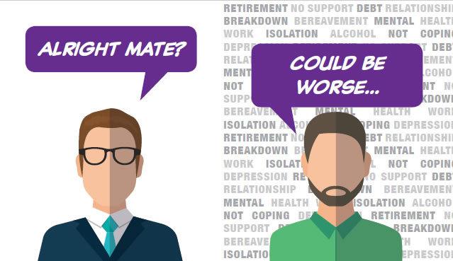
Dealing with denial
If they deny the problem, don’t criticise them. Acknowledge they’re not ready to talk.
Avoid a confrontation.
Examples of how you could respond to their denial include “It’s ok that you don’t want to talk about it but please call me when you’re ready to chat” or “Is there someone else you’d rather talk to?”
Tell them you’re still concerned about changes in their behaviour and you care about them.
Ask if you can enquire again next week if there’s no improvement.

Slide 27

⬧ TALK TO YOUR MATES
Talking is good for you – talk to a mate about what’s happening in your life and theirs
Make sure you have 2 or 3 really good mates and spend time with them when ever you can
A hint of talking about something important for you with someone important to you
If you want to talk to someone about a problem and don’t know how to do this, do something
with them. Men talk to others better when they
are involved in something – surfing, fishing,
playing sport, having a drink after work.

Slide 28
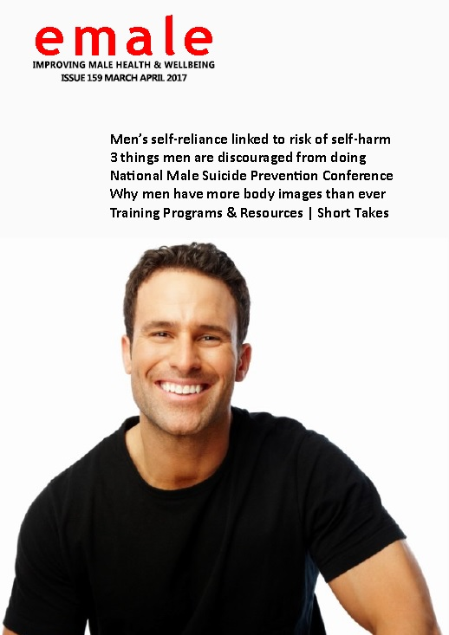
Men’s Health & Wellbeing Resources
emale
Australia’s largest free national bi monthly
e bulletin which provides people with the latest information and resources on men’s health and wellbeing.
Published first day of each month.
A promotional copy will be sent to you after today but you need to send an email with “subscribe” in subject line to be added to the mailing list.
To subscribe visit the website at
www.menshealthservices.com.au

Slide 29

Questions and Discussion Time
Greg Millan
Men’s Health Consultant
men’s health SERVICES
M 0417 772 390
greg@menshealthservices.com.au
www.menshealthservices.com.au
Three months follow up support available by phone or email.
Thanks for being a part of this webinar

